Slide 1
Singleton & Strategy Design Pattern Analysis
Author: Árnilsen Arthur
Year: 2022

Slide 2
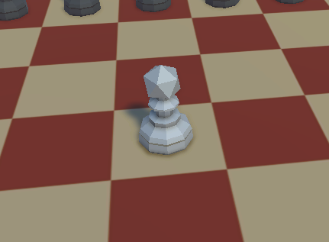
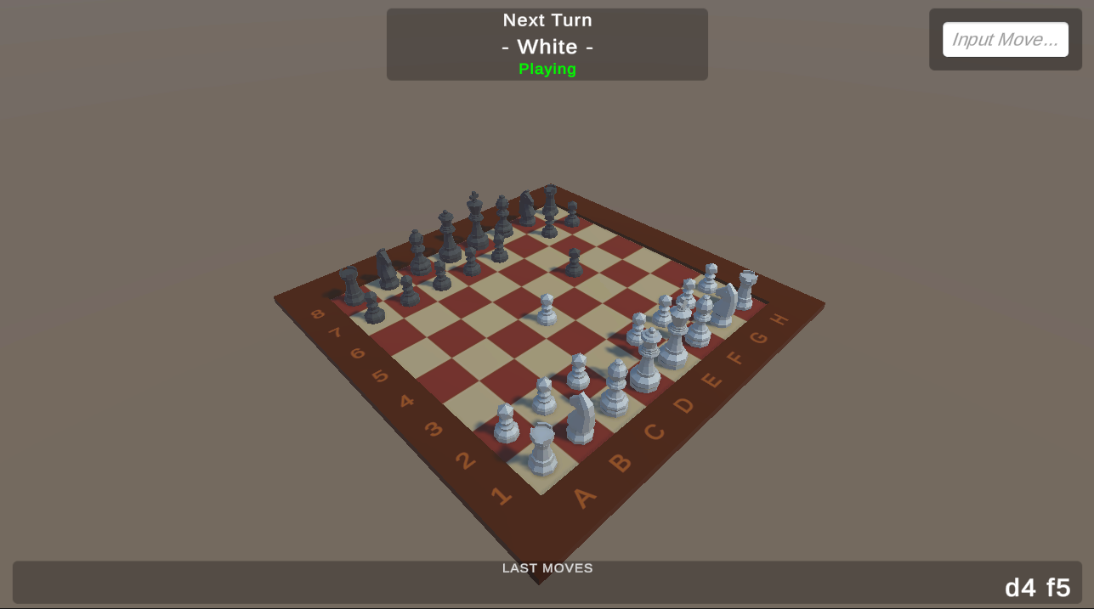
Project: Chess Game

Slide 3
Singleton

Slide 4
Singleton
Single instance classes
Good for game controllers (actual usage)
Static reference that can be accessed / used by other classes

Slide 5
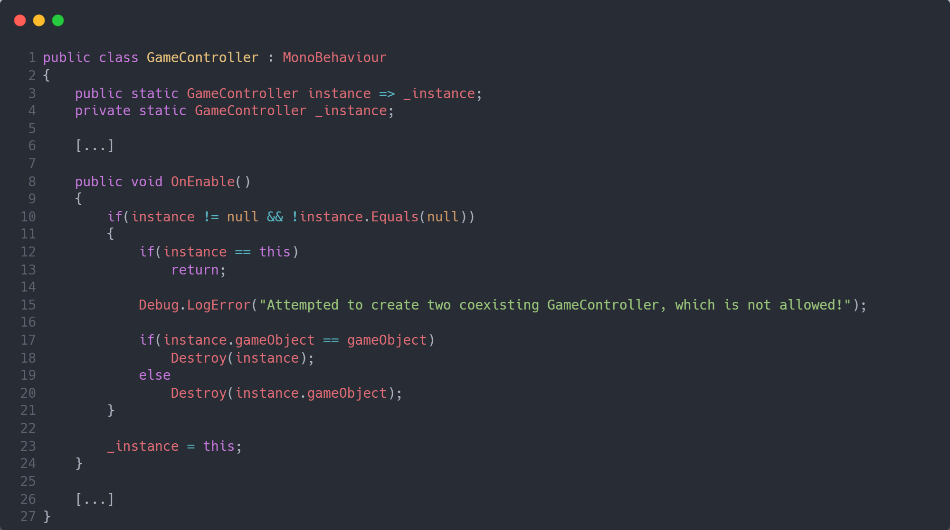
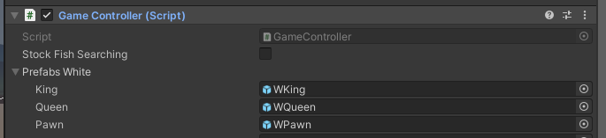
GameController instance definition

Slide 6
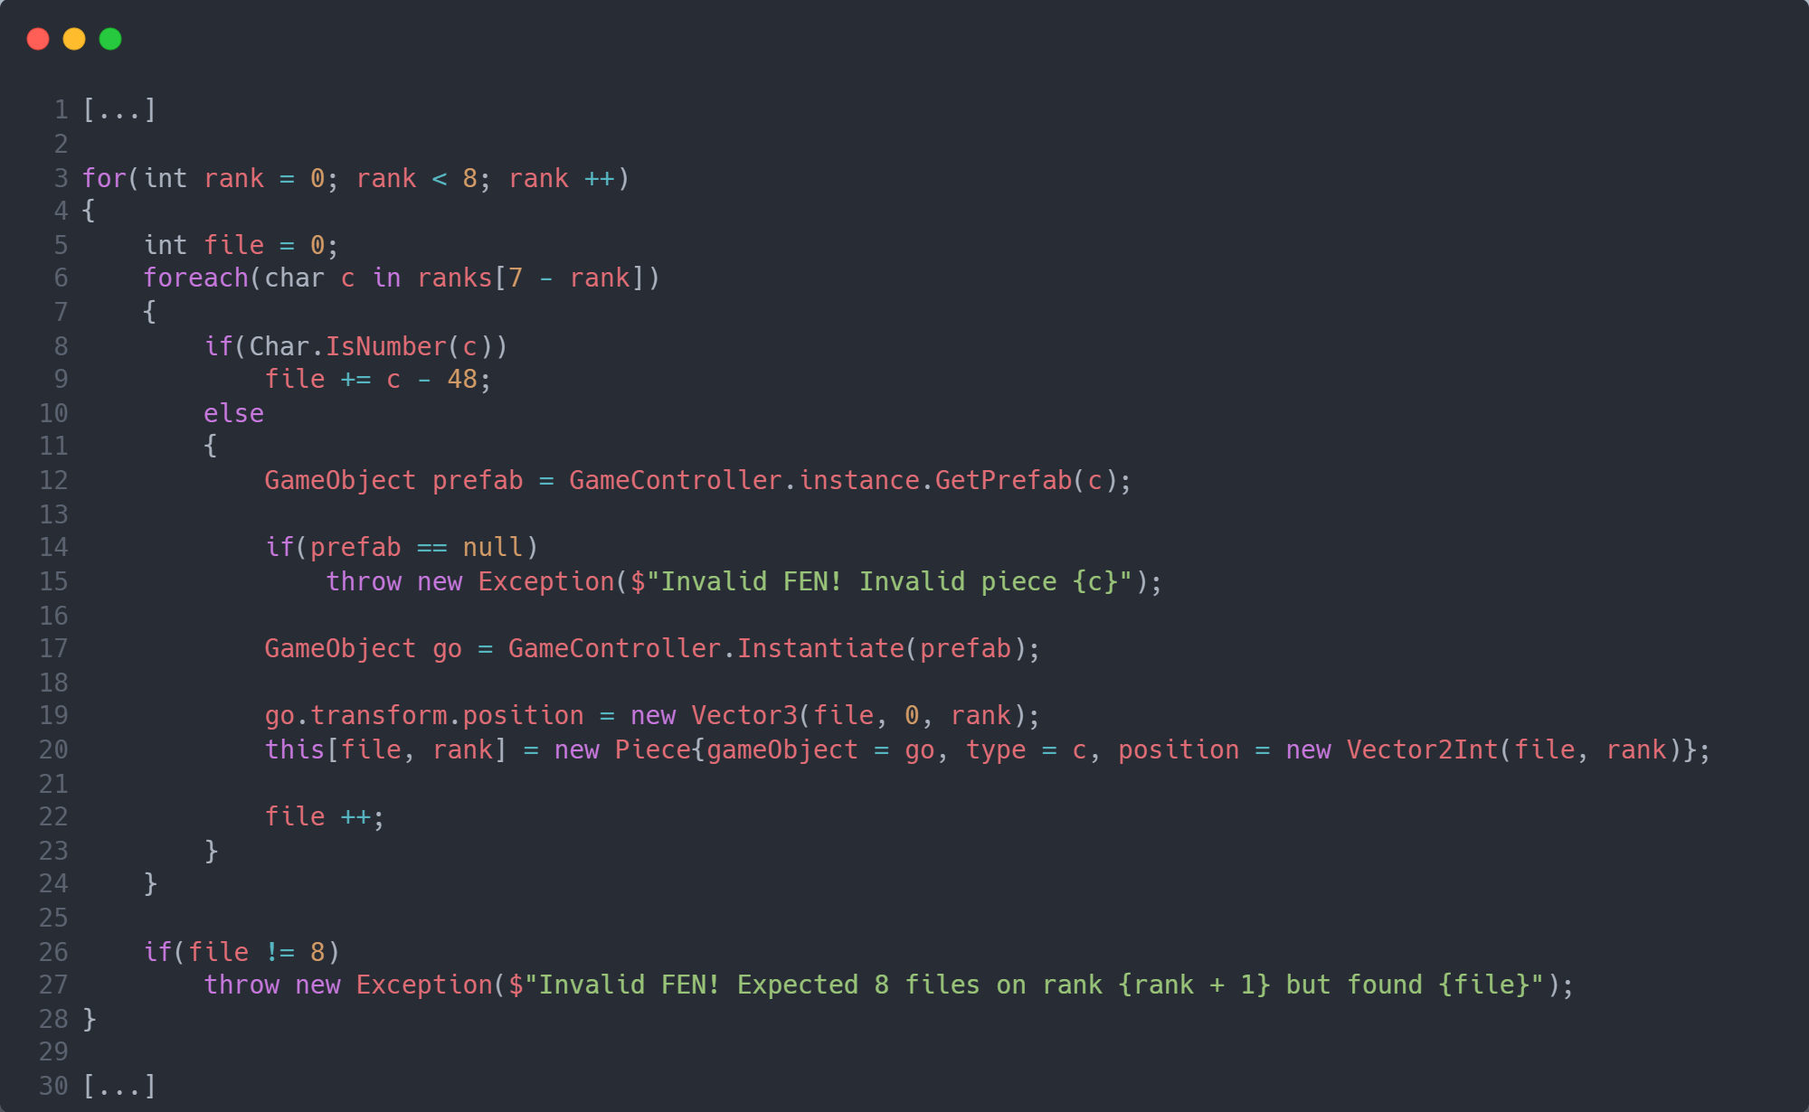
GameBoard accessing GameController.instance

Slide 7
Strategy Design Pattern

Slide 8
Strategy
You can choose the behaviour of a object without changing the object itself
You can reuse the same strategy object for more than one object
Very good for high-speed-demanding algorithms (all well-known chess AIs uses the strategy design pattern for high speed move generation)
Very good for light-objects (as chess pieces, that don’t have additional data)

Slide 9
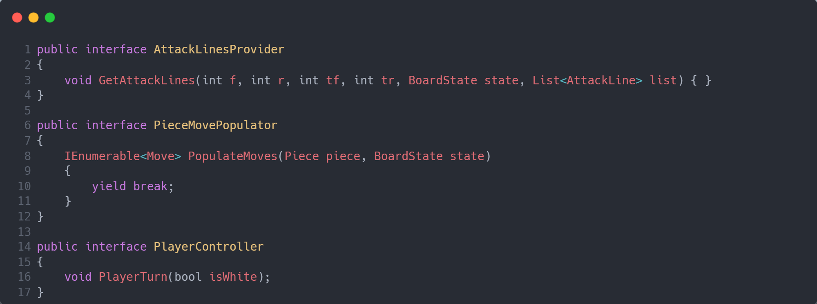
Strategy base interfaces

Slide 10
PlayerController Diagram
AutoPlayerController
DefaultPlayerController
PlayerController
PCRandomPlayerController
BaseInterface
PCSimplePlayerController
PCStockfishPlayerController

Slide 11
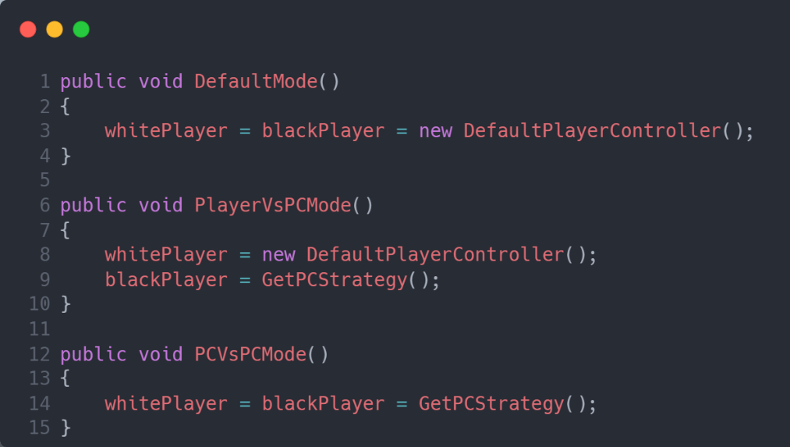
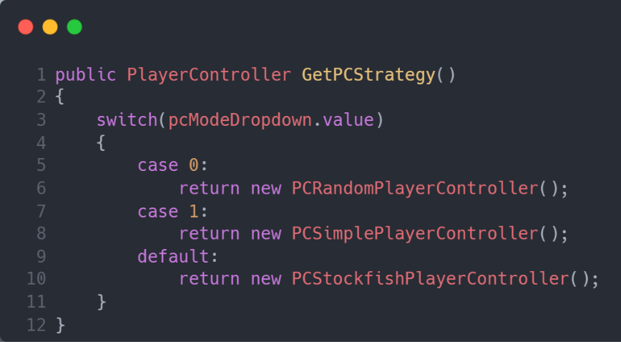
Switches between PlayerController strategies

Slide 12
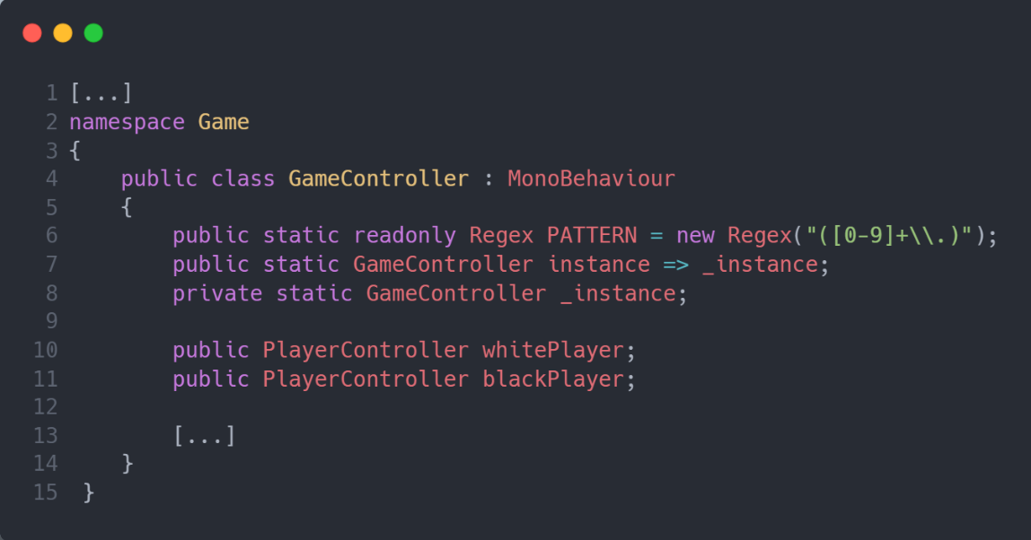
GameController class structure

Slide 13
PieceMovePopulator Diagram
PieceMovePopulatorBishop
PieceMovePopulatorKingCastler
PieceMovePopulatorKing
PieceMovePopulator
PieceMovePopulatorRook
BaseInterface
PieceMovePopulatorQueen
PieceMovePopulatorRookCastler
PieceMovePopulatorKnight
PieceMovePopulatorPawn

Slide 14
AttackLinesProvider Diagram
AttackLinesProviderDiagonal
AttackLinesProviderKing
AttackLinesProvider
AttackLinesProviderKnight
BaseInterface
AttackLinesProviderPawn
AttackLinesProviderStraight

Slide 15
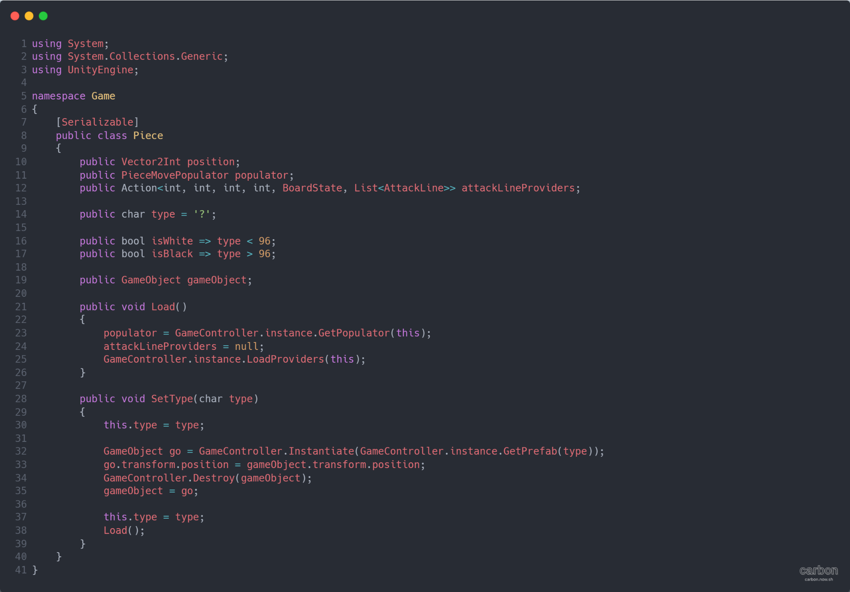
Piece class structure

Slide 16
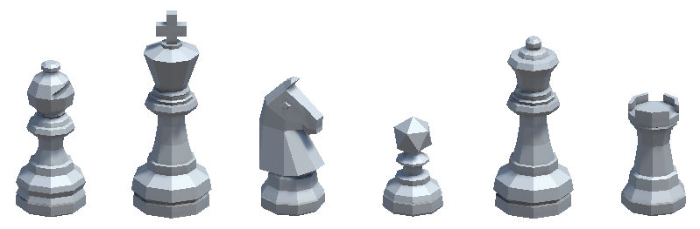
Piece
Diagonal
King
Knight
Pawn
Diagonal
Straight
Straight
Bishop
King
Knight
Pawn
Queen
Rook
KingCastler
RookCastler

Slide 17
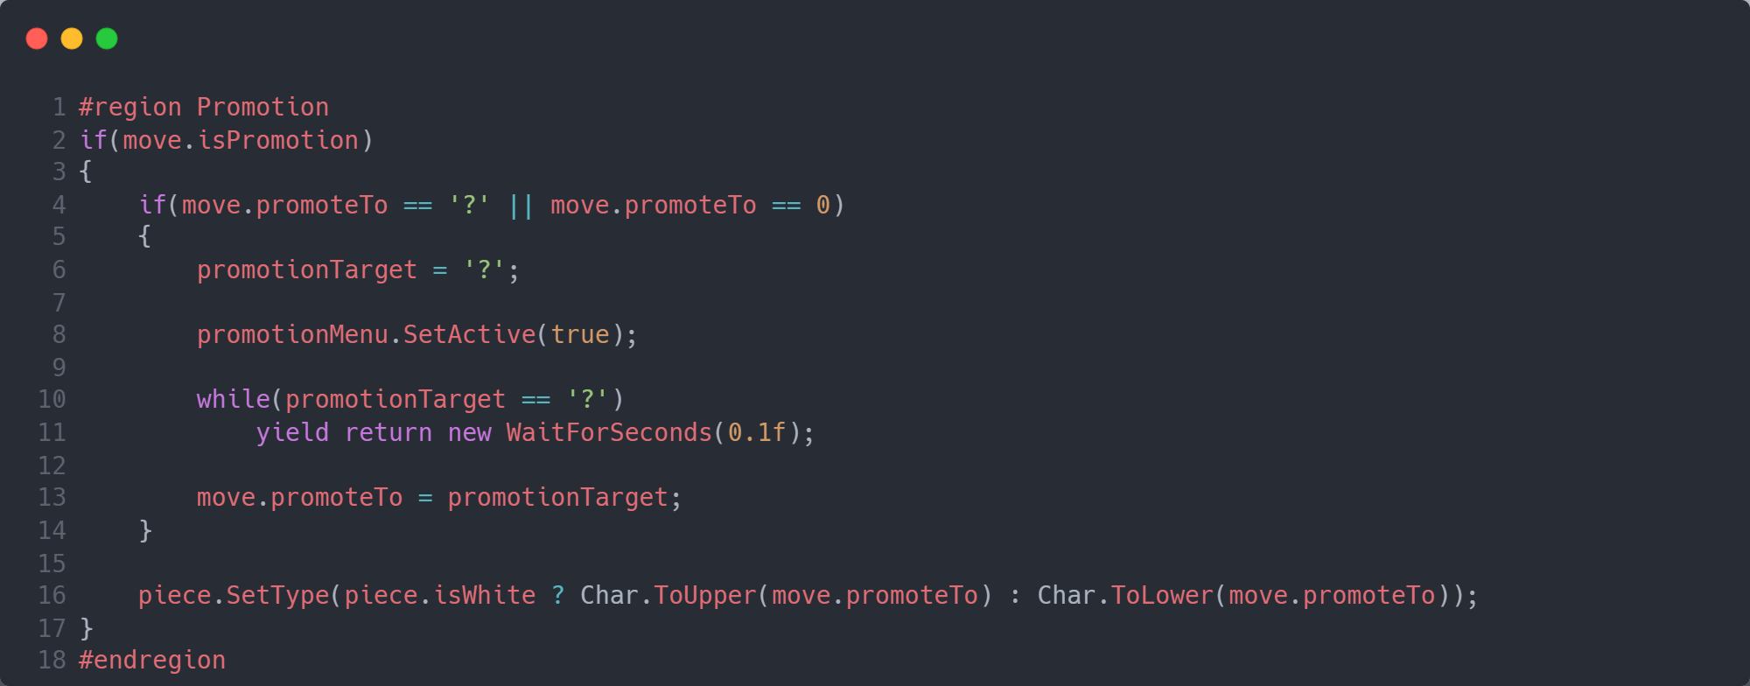
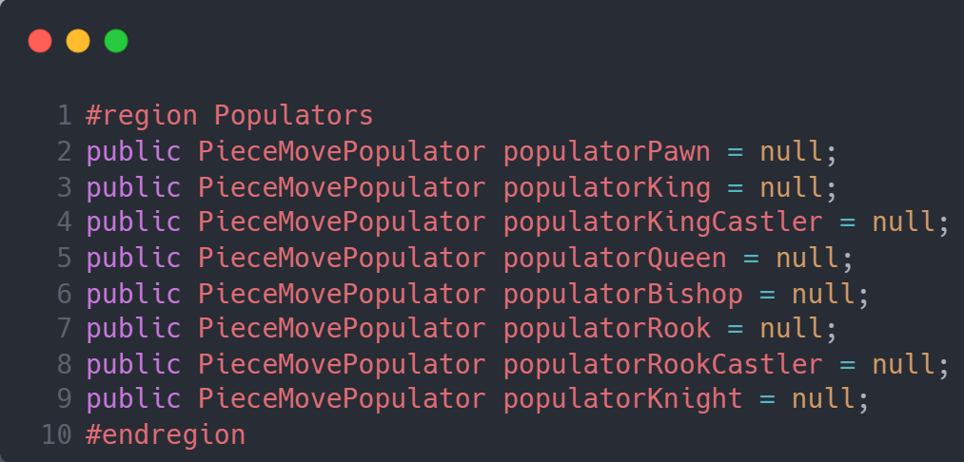
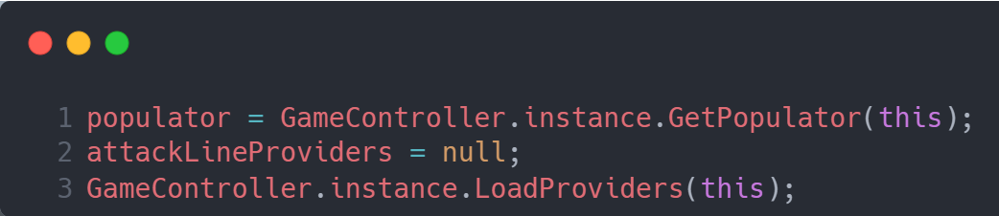
Changing Populator / Provider on Castle / Promote

Slide 18
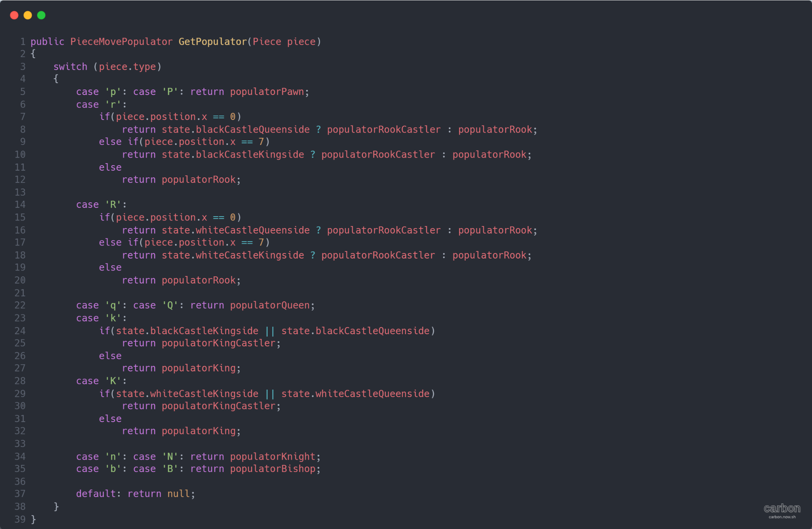
Populator assignment method

Slide 19
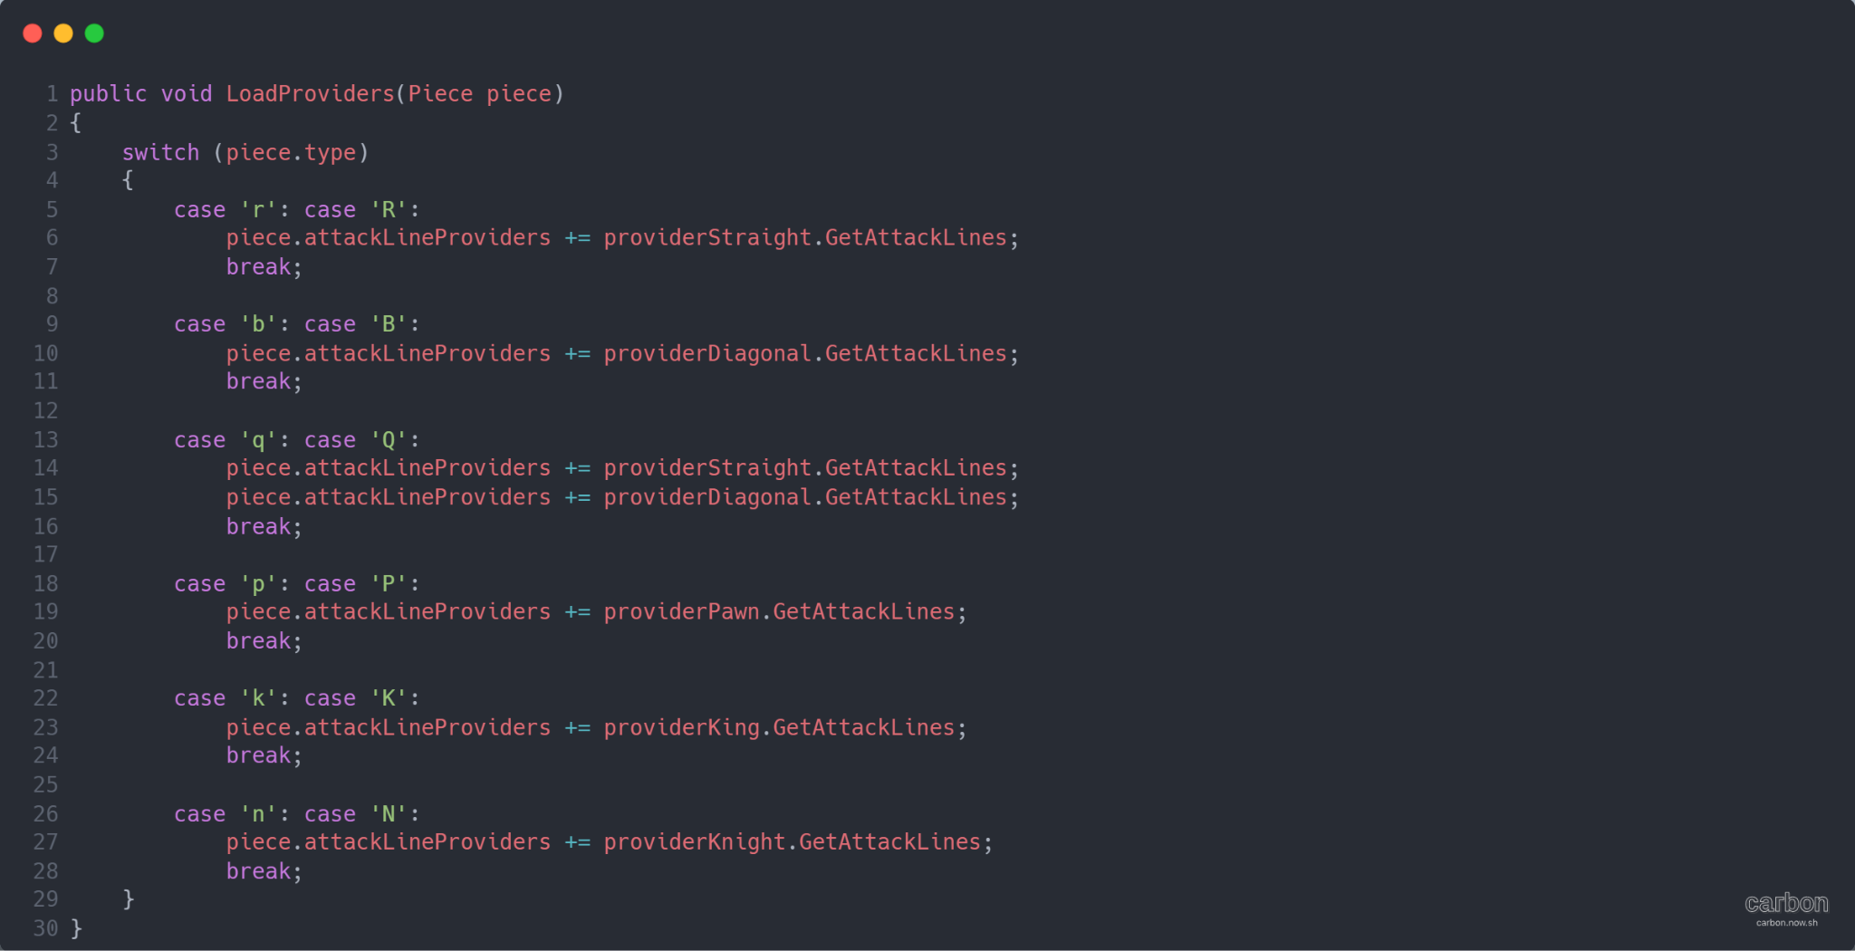
Provider assignment method

Slide 20
In-Game debug view

Slide 21
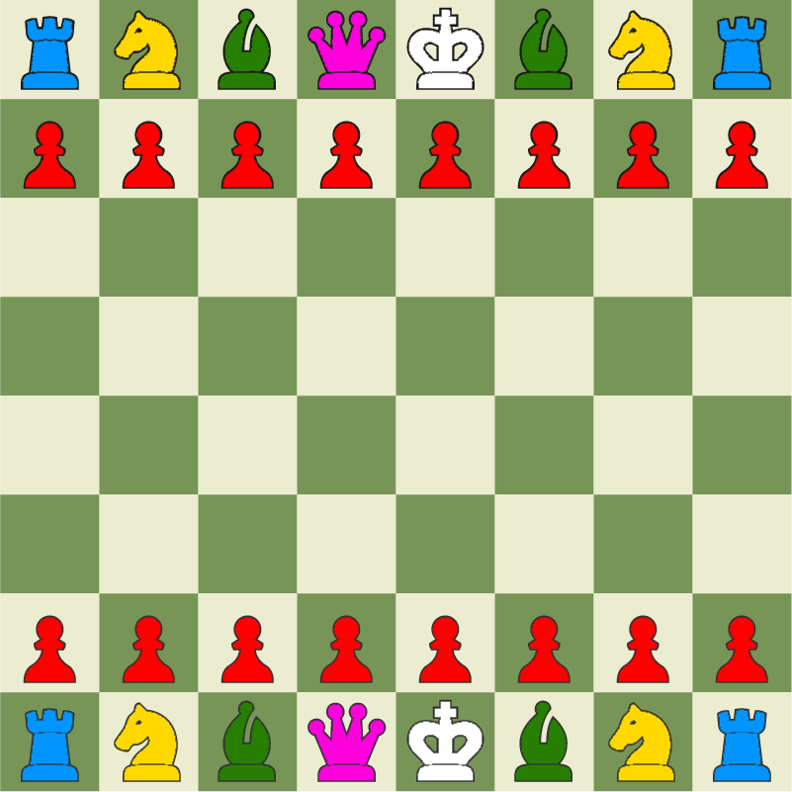
Why to use the Strategy Design Pattern?
You can use the same class for all the pieces of the same type
(32 objects down to only 6)

Slide 22
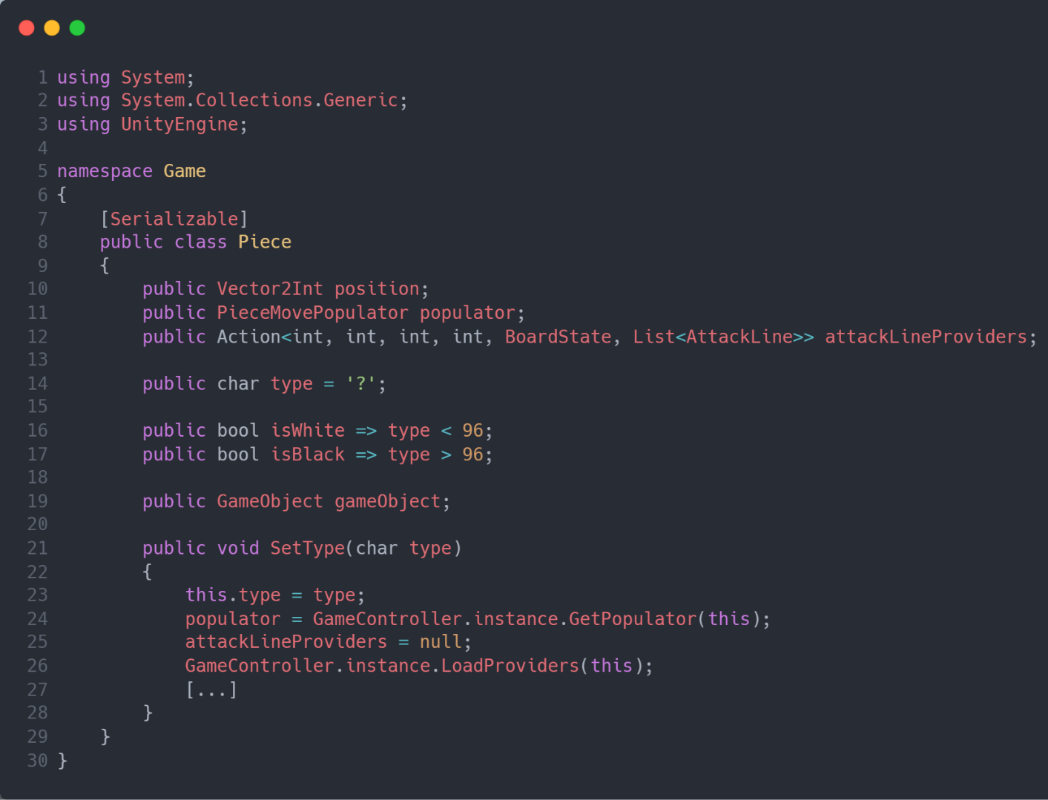
Why to use the Strategy Design Pattern?
You can just swap the strategy to change the behavior of a Piece, instead of having to create a new object (which would be slower and would use more memory)

Slide 23
Results

Slide 24
Results
Less object creation at real-time (-memory usage)
Fast movement generation (+speed on comparisons)
Better piece object structure (Flyweights)
I can use strategy methods as observers as well when needed

Slide 25

Thank you :)
Github repository with chess project source

